Slide 1
GIVETH BRANDING
How Faffy handles Unicorns

Slide 2
Handling unicorns can be a difficult and demanding task. The hard work put in by Kay and Grace made it much easier on Faffy though.
Following the routes they laid out, Faffy created 3 options for the Giveth logo / branding.

Slide 3
ROUTE 1
G-corn, baby!

Slide 4
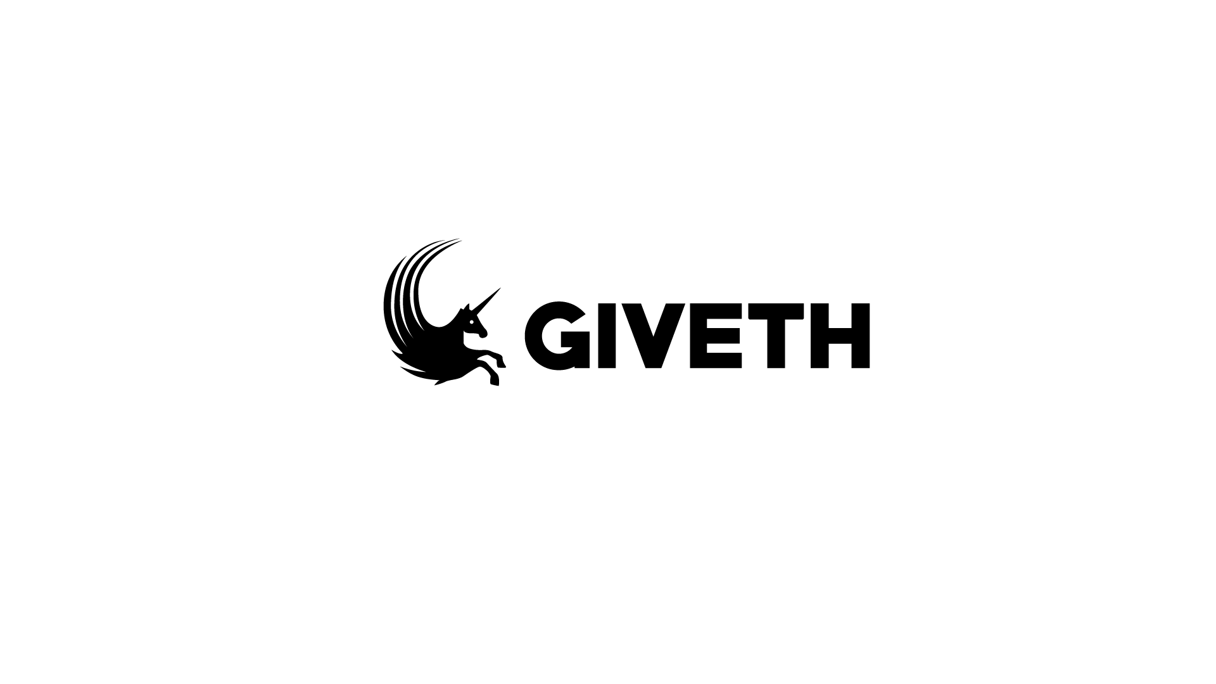
ROUTE 1 G-corn, baby!

Slide 5
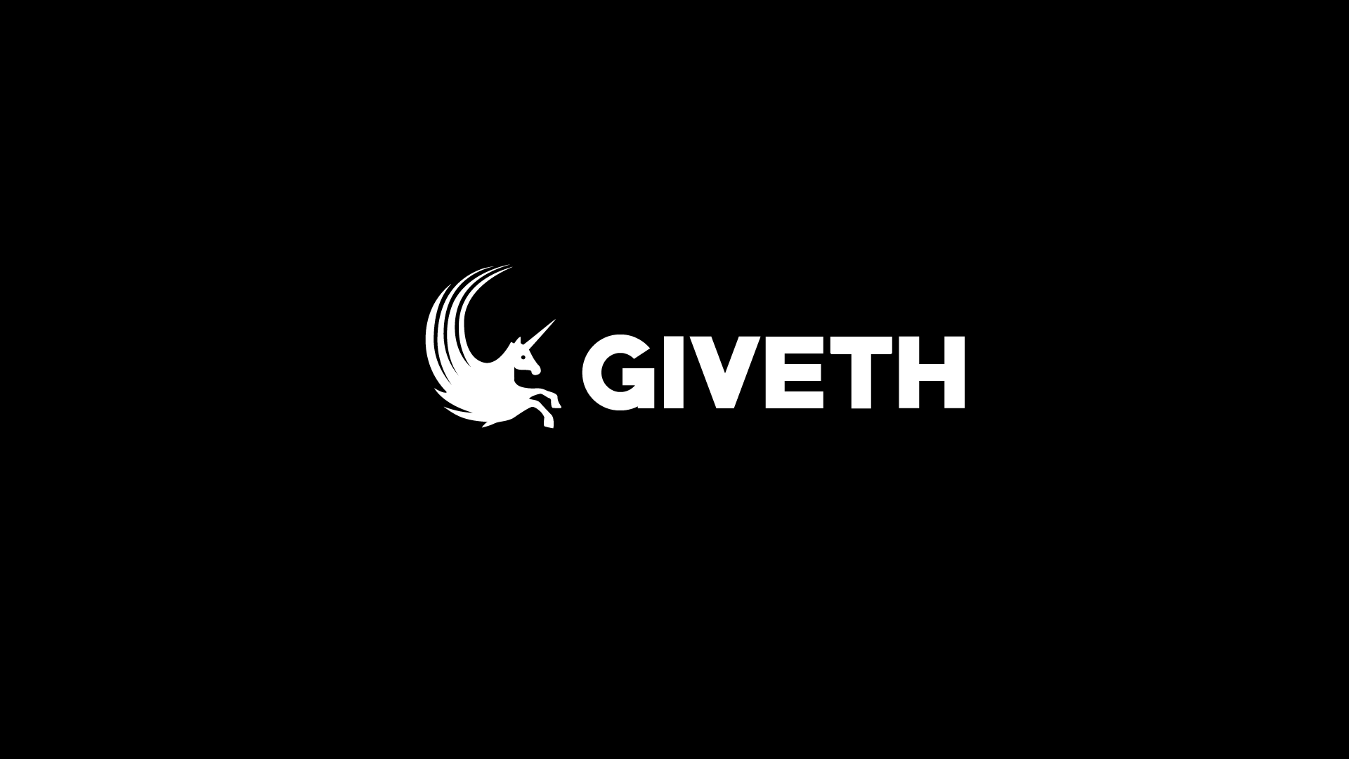
ROUTE 1 G-corn, baby!

Slide 6


This route is following the concept of the Unicorn having a G-shape and his manes are at the back, waving in the wind. Originaly created by Kay, refined by Faffy.
Complete version is logo + text. In a minimal version, the logo could be used seperate.
ROUTE 1 G-corn, baby!

Slide 7
ROUTE 2
Persistence will prevail

Slide 8
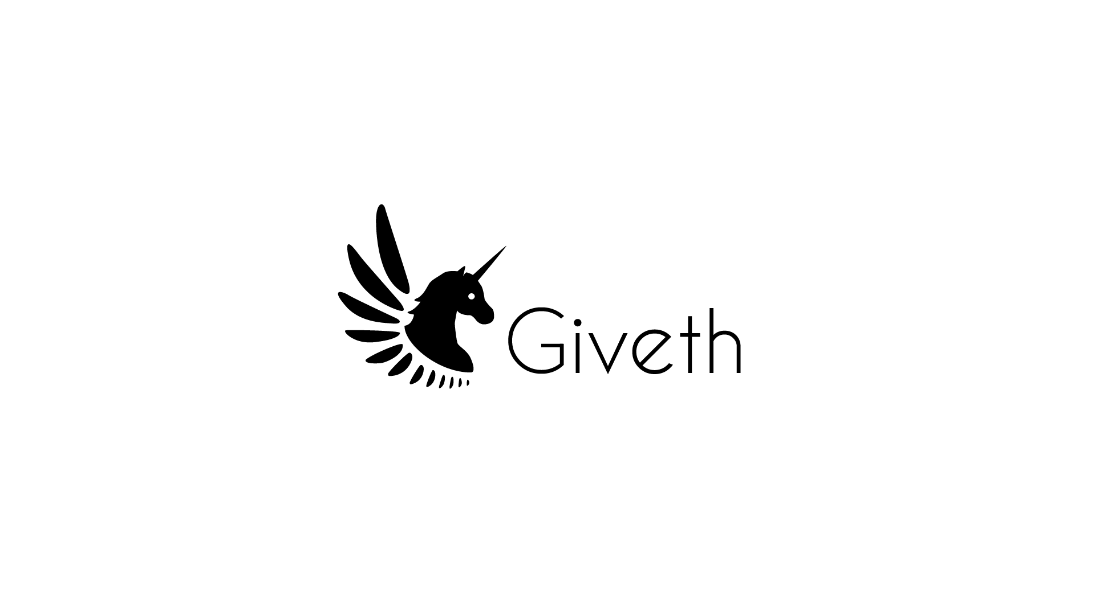
ROUTE 2 Persistence will prevail

Slide 9
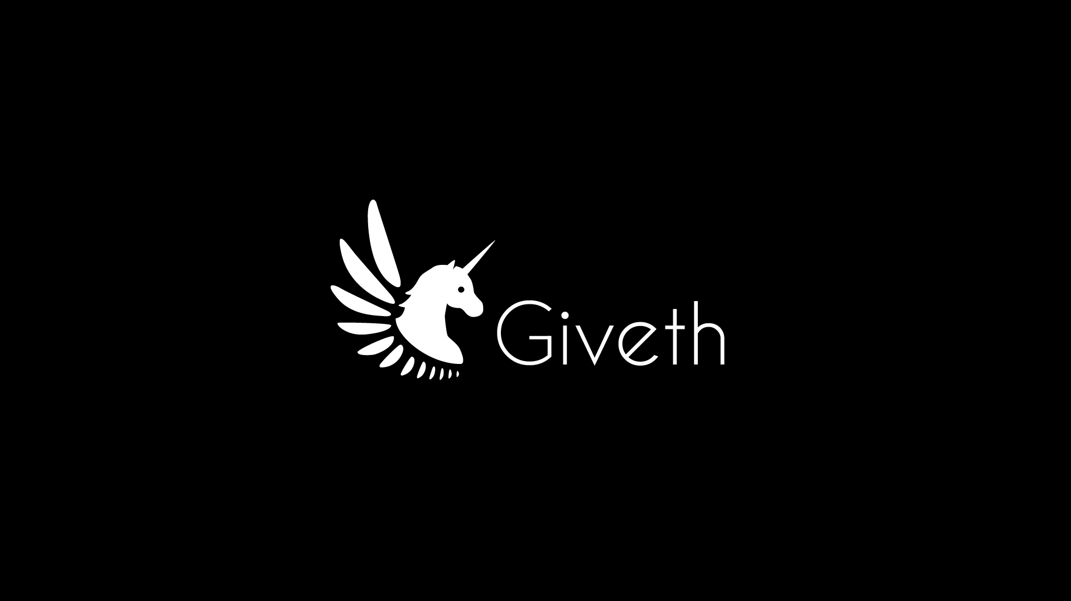
ROUTE 2 Persistance will prevail

Slide 10


In this route, the original Unicorn just had another revamp. Faffy was actually a fan of what Grace created, so he just refined the shapes and gave the whole thing a second life.
Here same thing: the complete version is logo + text, a minimal version = just the logo
ROUTE 2 Persistence will prevail

Slide 11
ROUTE 3
Handcrafted unicorn madness

Slide 12
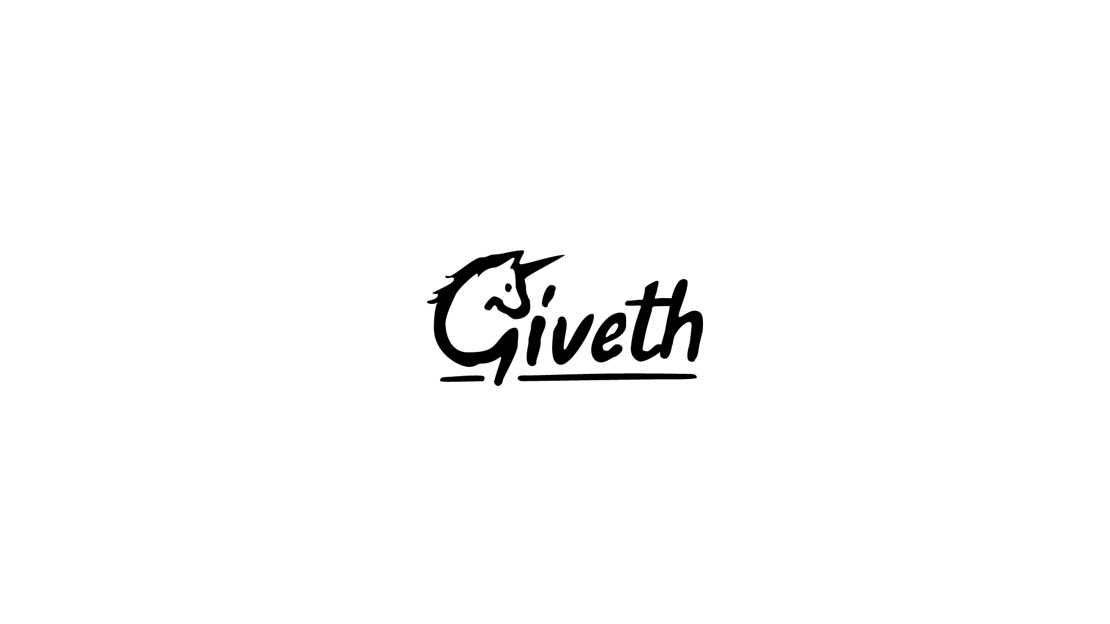
ROUTE 3 Handcrafted unicorn madness

Slide 13
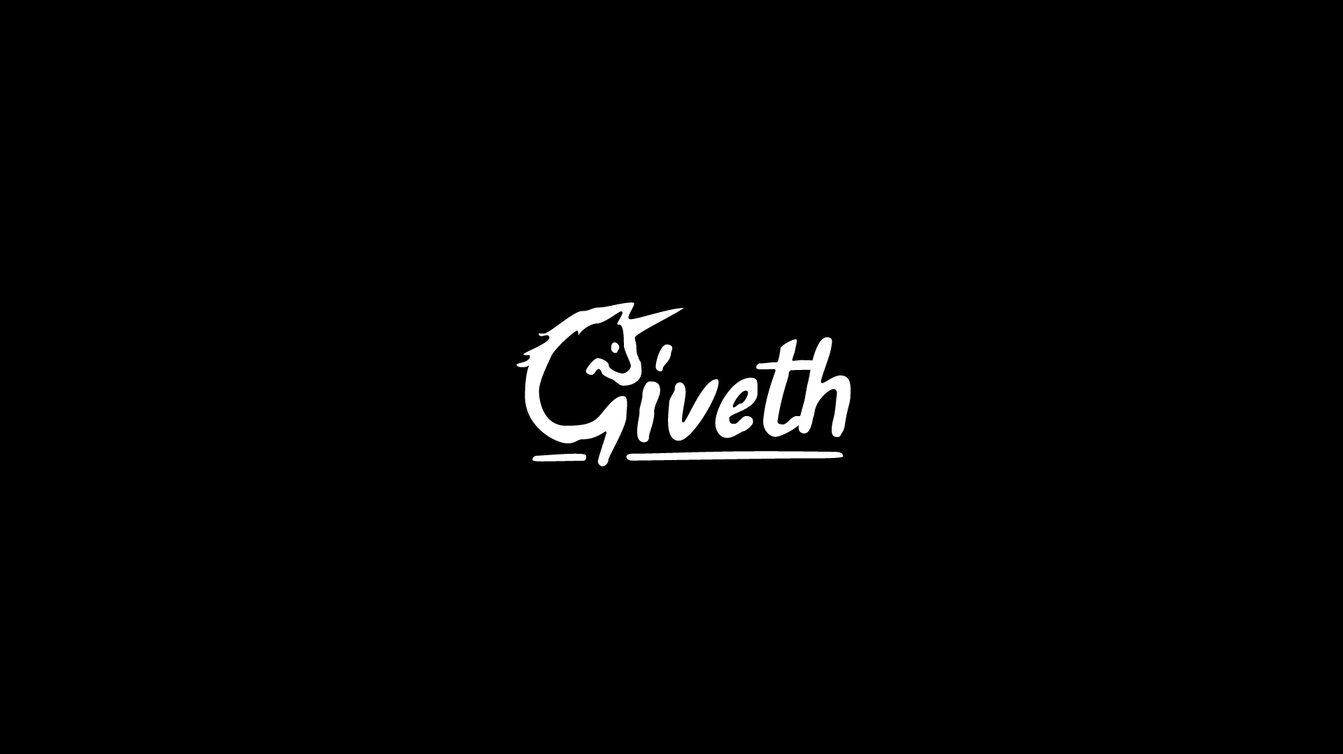
ROUTE 3 Handcrafted unicorn madness

Slide 14

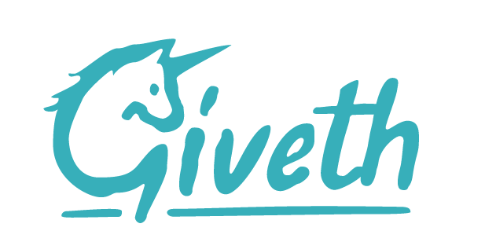
This route is straight from the hand of Faffy: started from a sketch he tried to keep the flow of handdrawn letters in a logotype.
This logo has a full version and minimal version, which is just the first letter, the unicorn-G. Because it is monotone, a lot of colours can be applied to it.
ROUTE 3 Handcrafted unicorn madness

Slide 15
RECAP
The idea of this document is to choose a logo. Once we’ve done this, we can carry on with the more general branding (fonts, colours, image use…)
So to conclude this, let’s put them all next to each other.

Slide 16


